Slide 1
The Newton Fund “Research and Innovation for Growth and Prosperity”
January 2016

Slide 2
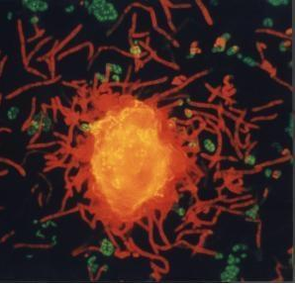
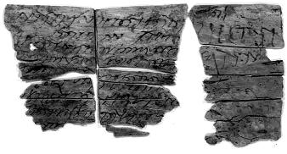
The Vision
The UK will use its strength in research and innovation to promote the economic development and social welfare of partner countries. By working together on bi-lateral and multi-lateral programmes with a research and innovation focus, the UK will build strong, sustainable, systemic relationships with partner countries. This will support the continued excellence of the UK research base and innovation ecosystem and will unlock opportunities for wider collaboration and trade.

Slide 3
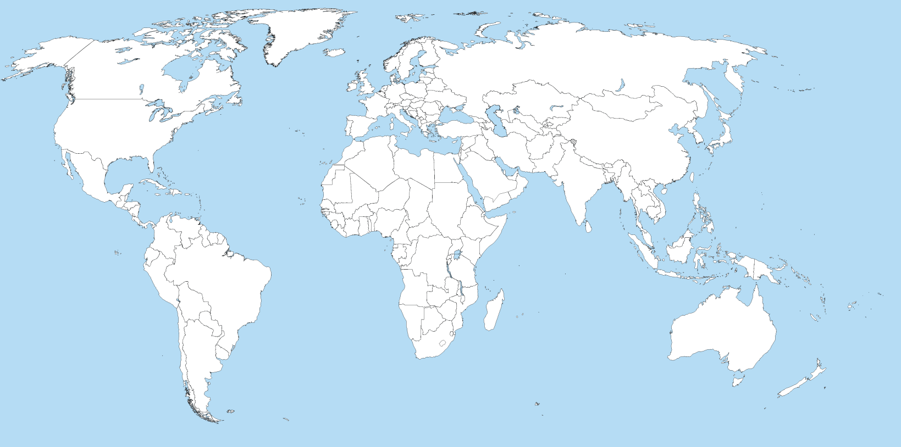
Our partner countries
Egypt
Turkey
Kazakhstan
Mexico
China
Colombia
Philippines
Vietnam
Brazil
Thailand
Chile
Malaysia
Indonesia
South Africa
(and sub-Saharan Africa)
India

Slide 4
UK Delivery Partners
Our aim is to build strong, sustainable and systemic links between every part of our research base and innovation ecosystem – and every part of yours

Slide 5
The Pillars
PEOPLE
RESEARCH
TRANSLATION
Notes:
5

Slide 6
People
School Student PhD Postdoc Young Prof Academician
STEM Pipeline
PhD
Partnerships
Newton International
Fellowships
Newton Advanced
Fellowships
Technical Training
& Employability
Developing People’s
Science & Innovation Capability
Leadership in Innovation
Researcher Mobility Schemes
Notes:
6

Slide 7
Research
Collaborative research programmes
Joint research calls
Joint centres
Access to research and innovation infrastructure
Food Security
Big Data
Living With Environmental Change
Global Uncertainties
Health
Energy
7

Slide 8
Translation
Research and Innovation Bridges
Global Innovation Capacity Building
Developing entrepreneurial skills in S&I small and medium sized enterprises
8

Slide 9
Newton UK – Thailand Research and Innovation Partnership Fund
“...up to £4 million per year could be available for Newton UK – Thailand…”
“…£2 million per year could be available for matching by Thailand…”

Slide 10
Thailand Delivery Partners
Our aim is to build strong, sustainable and systemic links between every part of our research base and innovation ecosystem – and every part of yours

Slide 11
Mechanism for in-country co-ordination
While our individual Delivery Partners will be forging links with their opposite numbers in-country, our Embassy, Consulate or High Commission will be making sure the whole programme really does represent a “whole system” partnership between the UK and our partner country.
BIS + FCO + SIN
RCUK
MRC
BBSRC
STFC
EPSRC
Academies
Royal Society
British Academy
Royal Academy of Engineering
British Council
Innovate UK
Science, Technology and Innovation Policy Office (STI)
National Science and Technology Development Agency (NSTDA)
Thailand Research Fund (TRF)
Agricultural Research Development Agency (ARDA)
Office of the Higher Education Commission (OHEC)
Institute for Promotion of teaching Science and Technology (IPST)
Office of the Vocational Education Commission (OVEC)
Office of the Basic Education Commission (OBEC)
Pijarana Samukkan
Research and Innovation Programme Manager
Prosperity Section
British Embassy in Bangkok
Tel. +662 305 8280
Email: pijarana.samukkan@fco.gov.uk

Slide 12
Overall Plan @ November 2015
Translation
Research
People
Institutional Links
Industry-Academia Partnerships
Leaderships in Innovation Fellowship
Infectious Diseases
Agriculture
Rice
…
? BigData
? Future City
Health
Cancers
STEM Education
PhD Scholars &
Supervisor Travel Grants
Mobility
& Fellowships
Professional Development
Researcher Links
Notes:
Big data for city planning and provision of urban services
Big data for capacity building and development

Slide 13
Overall Plan @ November 2015 (cont.)
 | 2014/15 | 2015/16 | 2016/17 | 2017/18 | 2018/9
STEM Education and STEMM
2. PhD Placement
3. Mobility
4. Advanced Fellowships
5. Professional Development
6. Researcher Links
7. Joint Research: Health, Rice, Future City & Big Data
8. Industry – Academia Partnerships
9. Leader in Innovation Fellowships
10. Institutional Links
11. SEA Capacity Building in Innovation

Slide 14
Newton UK-Thailand Research and Innovation Partnership Fund Opportunities
14

Slide 15
Calls Open
No. | Call | Status
1. | STEM Education: STEM Ambassadors STEM Personnel: teachers / principals Expert for curriculum revision / development | Open – 18 Jan Feb Feb / Mar
2. | PhD Placement Scholars & PhD Travel Grants for Supervisors
3. | Mobility | Open (6 Jan – 4 Mar)
4. | Advance Fellowships | Open (6 Jan – 4 Mar)
5. | Professional Development | May
6. | Researcher Links: Workshop grants Travel grants | April July
7. | Joint Research Health & Rice Digital | Close 2nd half of Year 2016
8. | Industry-Academia Partnership | Open – 18 Jan
9. | Leader in Innovation Fellowship | Sep / Oct
10. | Institutional Links | July

Slide 16
Mobility Programmes
Support early career and established researchers in embarking on research collaborations with their UK counterparts
Cover Natural Sciences, Engineering, Social Sciences and Humanities (Human Sciences)
Based around a new joint high quality research project
Awards for 1 year (Science & Engineering ⇒ £12,000 from RS + THB 500,000 from OHEC) (Social Sciences&Humanities ⇒£10,000 from BA+THB 500,000 from OHEC)
Includes visits, travel, subsistence, research expenses
Part of flexible mobility support seeding long-term collaborative partnerships that may go on to attract larger-scale funding
http://www.britac.ac.uk/funding/guide/newton.cfm
https://royalsociety.org/grants-schemes-awards/grants/newton-fund/

Slide 17
Newton Advanced Fellowships
Fellowships to support early to mid career researchers (up to 15 years post PhD).
Researchers who have already established (or are well advanced in the process of establishing) a research group or research network
Aim – To support the development of their research strengths through collaboration and for more formalised training and development.
Up to two years, with multiple short periods in the UK
Fellowship will provide a salary top up, research support, training costs, exchange of staff and travel and subsistence (£37k per year from the Academies + THB 1.5 million from TRF )
Cover Natural Sciences, Engineering, Social Sciences and Humanities (Human Sciences).
http://www.britac.ac.uk/funding/guide/newton.cfm
https://royalsociety.org/grants-schemes-awards/grants/newton-fund/

Slide 18
Industry-Academia Partnership Programme
Lead applicant must be Thai University partnering with an industry organisation and a UK institution. The industry partner may also be considered as the UK institution if it is headquartered in the UK.
Total funding of £10,000 – £50,000 over two years to support salary, travel and accommodation costs for activities and workshops
Industry-Academia cooperation - IAPP will fund collaboration projects between industry and academia organisations which will aim to enhance education or research outcomes in universities.
Disseminating learning - funds workshops to help spread good practices and escalate impact of the exchanges to a broader level.
Building UK Linkages - Projects must also include a UK partner institute – academic or industry - to build innovation and engineering links between both countries.
http://www.raeng.org.uk/grants-and-prizes/international-research-and-collaborations/newton-fund-programmes

Slide 19
Number of Applications 2014/15
Programme | Number of Applications | Number of Awardees
1. PhD Programme | 39 | 29
1.1 PhD Placement
1.2 Travel Grants for supervisors | 25 | 11 supervisors (22 PhD students)
2. Researcher Links | 16 | 5 workshops (400 researchers)
2.1 Workshop Grants
2.2 Travel Grants | 22 | 19
3. Professional Development | 134 | 20
3.1 PD for mid-career researchers
3.2 PD for project officers | 32 | 15
3.3 PD for Food Industry | 11 | 7
4. Researcher Connect | 194 | 194
5. Leaders in Innovation Fellowships | 22 | 15
TOTAL |  | 732

Slide 20
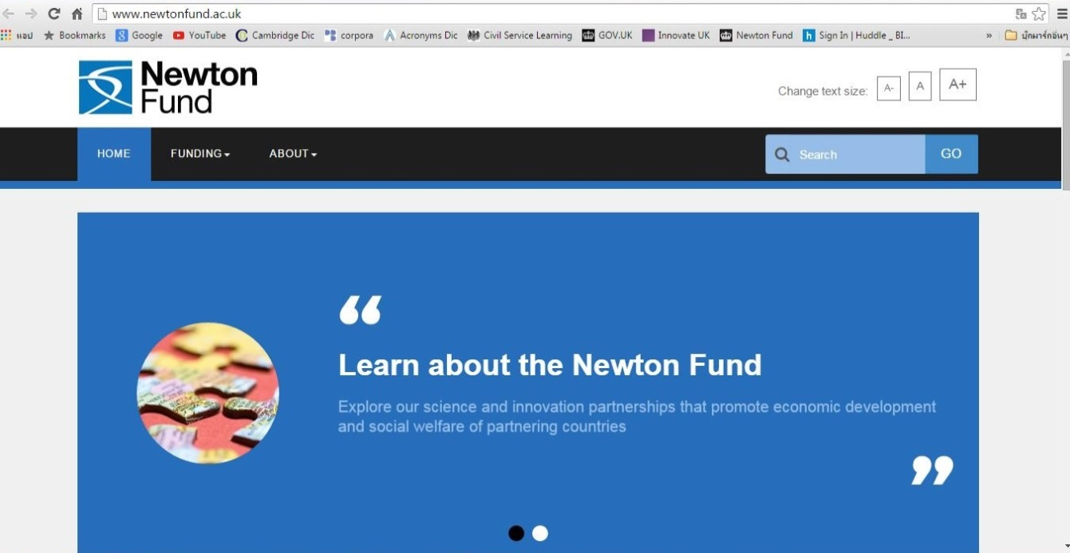
All About Newton
http://www.newtonfund.ac.uk/
About Newton Fund
How to fine UK partners
Funding Opportunity
What is ODA
Partnering Countries
Partnering Organisations
Key Facts & Figures
Update News : Tweets

Slide 21
Finding Partners
Richard Syms is Professor of Microsystems Technology and Head of the Optical and Semiconductor Devices Group in the EEE Dept, Imperial College London. He has published widely on holography, guided wave optics, electromagnetics and microengineering, and has developed a wide range of microdevices, including miniature quadrupole mass spectrometers and RF probes for magnetic resonance imaging. In 2001, he co-founded the spin-out company Microsaic Systems, which manufactures the world’s only desktop electrospray mass spectrometer. He is a Fellow of the Royal Academy of Engineering, the Institute of Physics and the Institute of Electrical Engineers.
Magneto-Inductive Waves and Magnetic Resonance Imaging Periodic structures have long been of interest in electrical engineering, and many different arrangements of reactive elements have been devised for signal transmission and filtering. Renewed interest in periodic electrical structures was sparked by the realisation they can act as artificial media with novel properties, such as negative permittivity, permeability or refractive index. Such has been the explosion of activity that ‘metamaterials’ is now an entire field. Although many applications concentrate on exploitation of negative parameters (for example, perfect imaging and cloaking), other important engineering applications exist. In this talk, applications of a particular kind of metamaterial are described. This material supports magneto-inductive waves, which may easily be excited by precessing nuclear spins in magnetic resonance imaging. Theoretical background and experimental results are presented for passive and amplified MI waveguides. Applications in MRI are described, especially for patient protection in internal imaging. The long-term goal is early detection of cholangiocarcinoma (cancer of the biliary ductal system, which is epidemic in the Far East).

Slide 22
THANK YOU Pijarana Samukkan Research and Innovation Programme Manager British Embassy, Bangkok Tel. +662 305 8280 e-mail: pijarana.samukkan@fco.gov.uk

